Slide 1
Microsoft Azure AI Fundamentals: Document Intelligence and Knowledge Mining
Notes:
This content is meant to be taught in companion to: Microsoft Azure AI Fundamentals: Document Intelligence and Knowledge Mining - Training | Microsoft Learn

Slide 2
Agenda
Azure AI Document Intelligence
Azure AI Search
Notes:
Time estimates:
- Azure AI Document Intelligence: 15 minutes
- Azure AI Search: 15 minutes
- The lab exercise should take an additional 15 minutes

Slide 3
Learning Objectives
After completing this module, you will be able to:
1
Understand what Azure AI Document Intelligence does, and why organizations use it.
2
Describe knowledge mining and the problems it solves.

Slide 4
Azure AI Document Intelligence

Slide 5
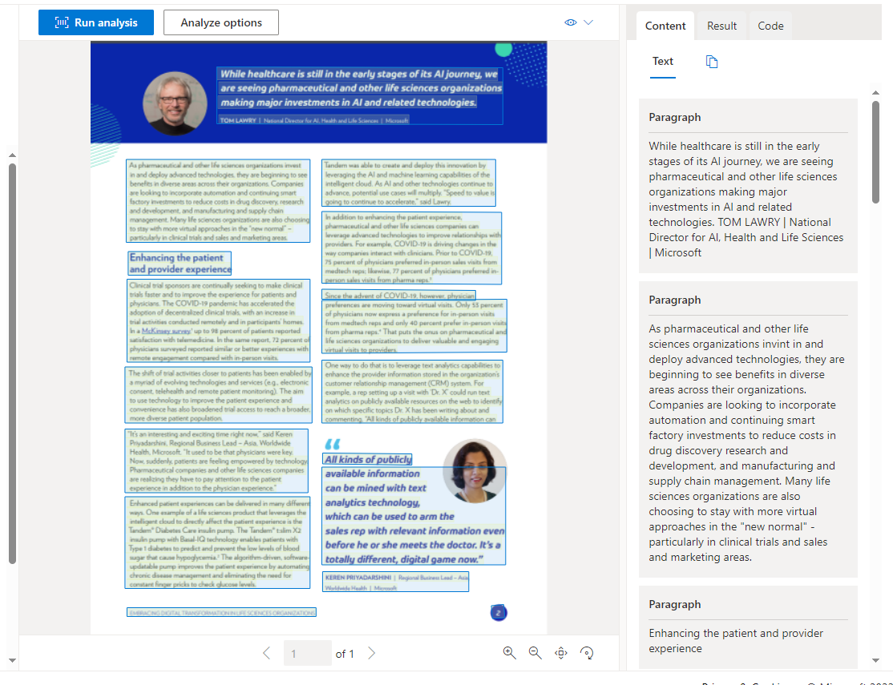
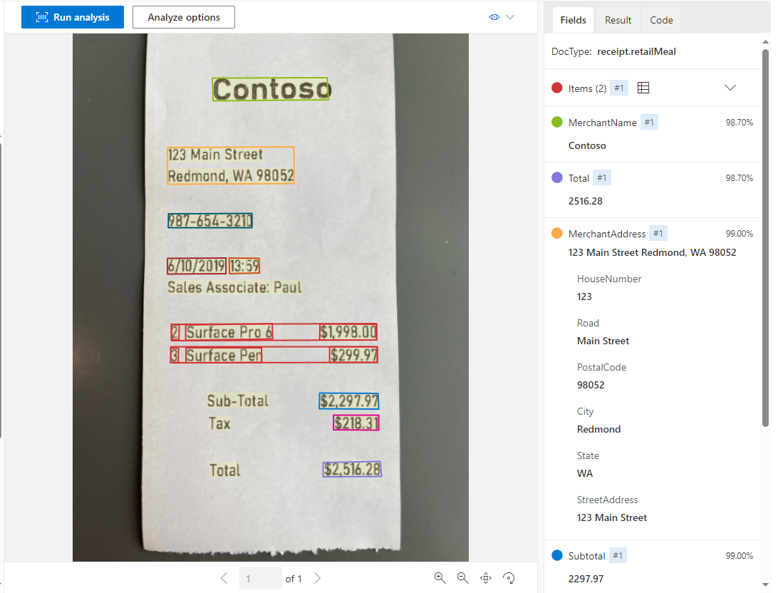
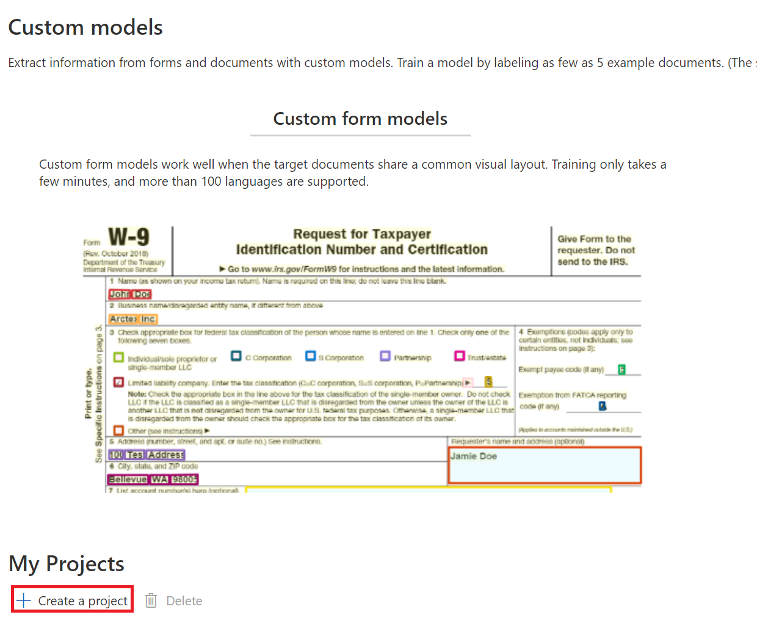
AI Document Intelligence services
Document analysis
Prebuilt models
Custom models
Returns structured data representations.
Regions of interest and relationships.
Configure Analyze options for free and chargeable analysis
Invoices
Receipts
ID
Recognizes and extracts key-value pairs.
Train models with at least five sample data.
Identify fields of interest to your organization.
Notes:
This was previously called Forms Recognizer. Renamed Document Intelligence services to reflect AI in document processing.
Document Intelligence automatically reads, understands, and analyses business documents
Explain that Document Intelligence is made up of three related services:
- Document analysis
- Prebuilt models – machine learning models trained for specific types of forms, such as receipts (including hotel receipts, gas receipts, etc), invoices, ID.
- Text and field names are identified
- Available as JSON for input into a database
- Custom models
- Train with as few as five sample forms
- Requires an Azure storage account
- Can customize the machine learning models for forms common in your organization

Slide 6
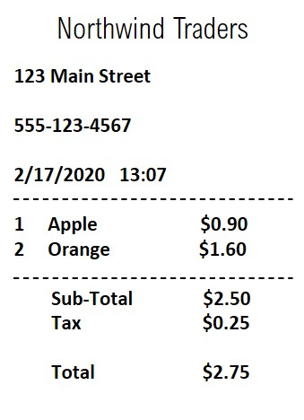
Analyzing forms with the Document Intelligence service
Extract information from scanned forms in image or PDF format.
Use the pre-trained models for common document types, such as invoices, receipts, IDs, etc.
Train a custom model using your own forms.
Models perform semantic recognition of form fields – not just text extraction.
Notes:
After talking to the slide for a minute or so, use the exercise at https://docs.microsoft.com/learn/modules/analyze-receipts-form-recognizer/3-analyze-receipts/ to demonstrate the service
The Document Intelligence service does more than just detecting and extracting text. It enables you to use models that "understand" the form fields – for example, identifying specific types of data such as addresses, phone numbers, dates, times, and quantities; and understanding the relationship between field labels and values.
You can use Receipt analyzer to train your own custom form extraction models based on your own scanned forms, or you can use pre-trained models to extract information from common document types, such as receipts, business cards, and invoices.
Document Intelligence uses OCR as its foundational technology to additionally extract structure, relationships, key-values, entities, and other document-centric insights.

Slide 7
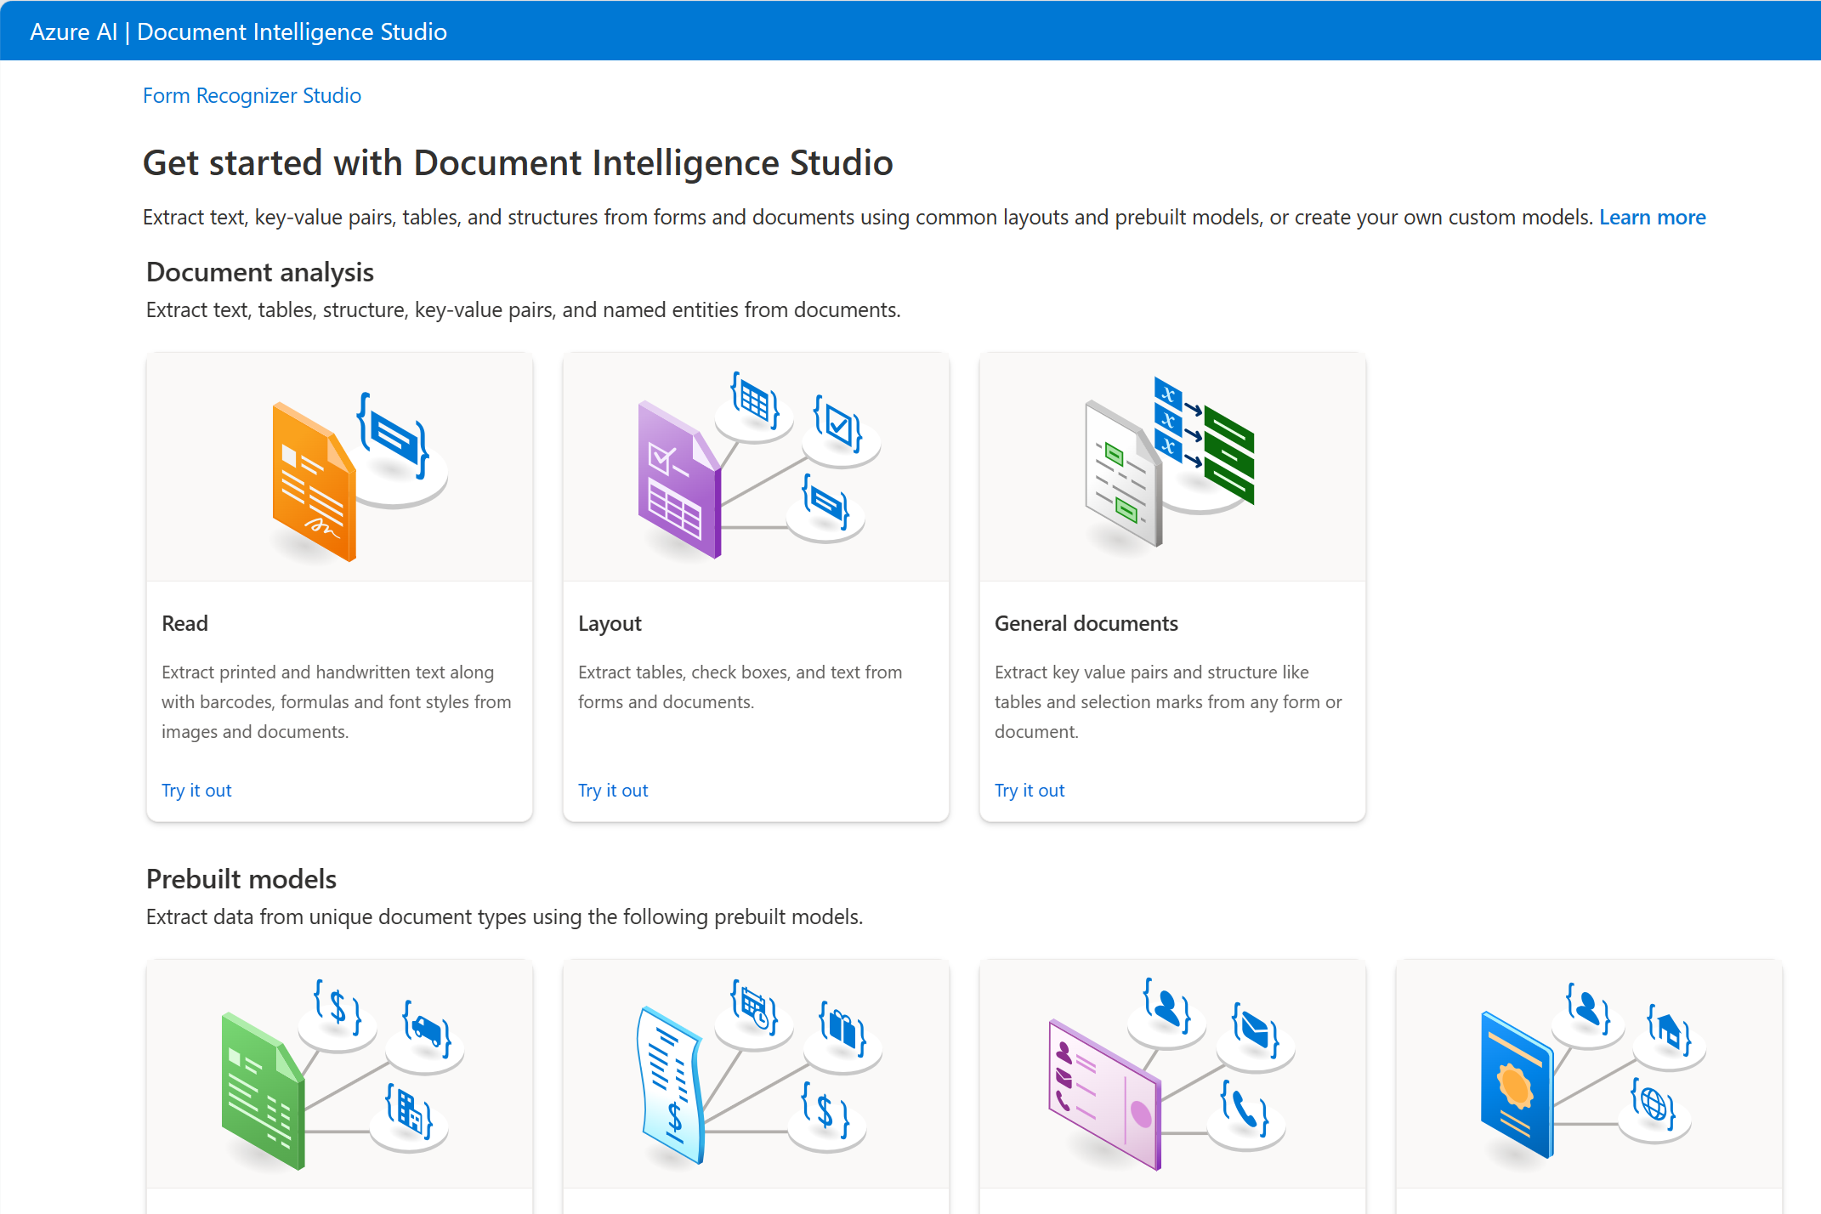
Document Intelligence Studio
Getting started with Document Intelligence
Using a no code approach you can explore the functionality using samples and your own documents.
First - create a resource
Document Intelligence resource
AI services resource
Then Enable the resource in Document Intelligence Studio.
Getting Started page: select a model to try.
Notes:
Resources can be created either through Document Studio, or through the Azure portal
Delete resources through the Azure portal
Explain that AI services resource includes several different AI capabilities – Document Intelligence resource is a single service resource

Slide 8

Exercise: Extract form data in Document Intelligence Studio
Use the hosted environment and Azure credentials provided for this exercise.
In this exercise, you will explore the Azure AI Document Intelligence service to analyze a receipt.
The instructions are also available on Learn: https://aka.ms/ai900-document-intelligence
Notes:
Point out that exercises are also available on Microsoft Learn for all of the other tasks demonstrated and discussed in this PowerPoint. https://microsoftlearning.github.io/mslearn-ai-fundamentals.

Slide 9
Azure AI Search

Slide 10
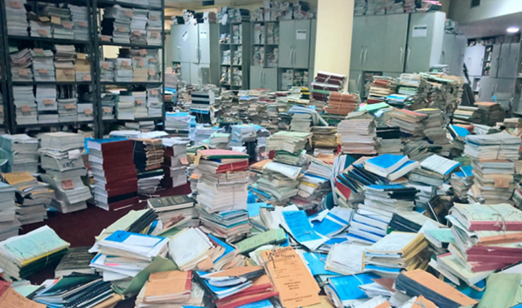
What is knowledge mining?
Organizations have a lot of content
Data is locked away in documents, PDFs, hand-written notes, etc.
Time consuming and labour intensive to find data.
Knowledge mining finds insights – at scale.
Azure AI Search is Azure’s AI-powered knowledge mining platform.
Solutions provide access through, for example:
Search, eg bots to answer questions
Dashboards
Business applications
Availability for further analysis
Notes:
Everyone is familiar with web search platforms such as Google or Bing. But how is data searched within organizations?
Discuss problems of finding data within organizations, such as knowing where the data is held, data held by departments, the time required to scan documents, etc.

Slide 11



Azure AI Search solutions
Ingest
AI enrichment & index
Explore
Azure Blob Storage containers
Azure SQL Database Documents in Cosmos DB
Azure Data Lake Storage Gen2
Azure Table Storage
AI enables deeper understanding
Extract information & patterns
Azure AI services
Vision, Natural Language Processing, etc.
Indexing makes content searchable
Search performed on indexes
Results used:
Within applications
Create data visualizations
Notes:
AI Search requires data in JSON format.
Unstructured data supported through Azure Blob Storage, NoSQL support in CosmosDB, Data Lake storage and table storage
Relational data support through Azure SQL Database, SQL Server, etc.

Slide 12
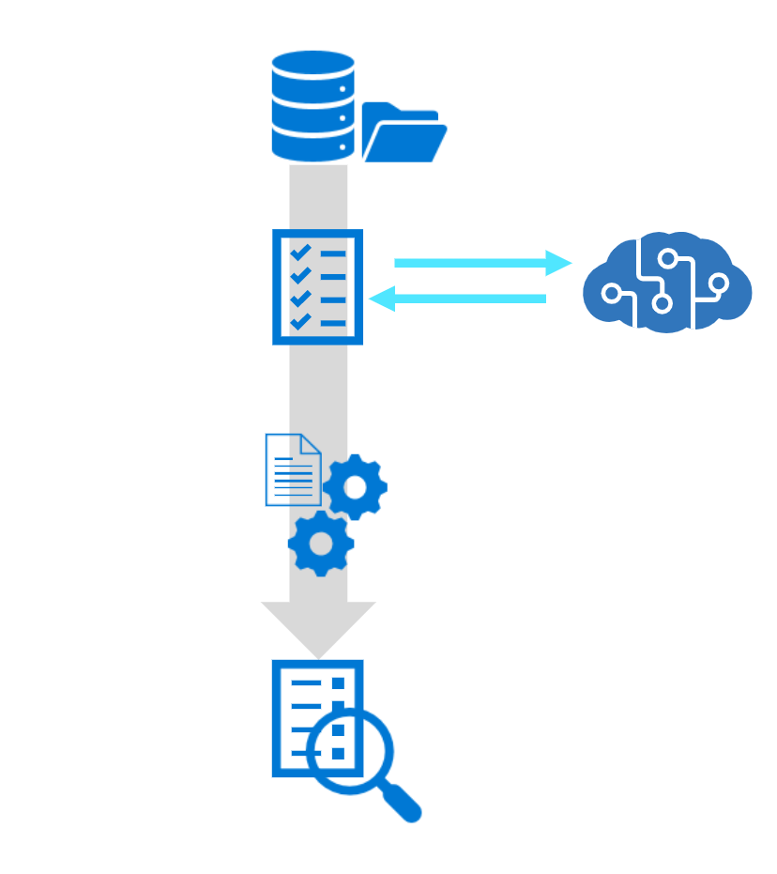
AI enrichment
In Azure AI Search
AI enrichment makes content more useful for search purposes.
Enriched content is created by skillsets that:
Recognize entities in text
Translate text
Evaluate sentiment
A skillset produces enriched documents
Consumed during indexing
Projected to a knowledge store
Serialized data is passed to the search engine for indexing.
Knowledge store
Data sink created by an AI Search enrichment pipeline.

Slide 13
Demo: Explore an Azure AI Search index (UI)
Follow along on the exercise page at: https://aka.ms/ai900-ai-search
In this demo, you will see how AI enrichments add to search capabilities.
Notes:
Instructors: we recommend you complete the exercise ahead of time https://microsoftlearning.github.io/mslearn-ai-fundamentals/Instructions/Labs/11-ai-search.html. During class, you can demonstrate the service.
Important: Students are not expected to replicate the process of creating a AI Search Index in the exam. This demo’s purpose, like the others, is to give a sense of the capabilities of the service.

Slide 14
Knowledge check
Which problem is Document Intelligence designed to solve?
Reading text from large volumes of scanned documents
Extracting key value pairs from forms, for input into a database
Extracting positive and negative sentiment from scanned images
You want to extract information and perform semantic recognition on the extracted fields. What service would you use?
AI Vision
Optical Character Recognition
AI Document Intelligence
Which two steps are part of building a AI Search solution?
Creating databases of structured data, and indexing the data
AI enrichment and indexing
Identifying necessary skillsets to build indexes
Notes:
Allow students a few minutes to think about the questions, and then reveal the correct answers.

Slide 15

Summary
Azure AI Document Intelligence
What is AI Document Intelligence?
Three types of AI Document Intelligence services
Analyzing specific forms with the AI Document Intelligence service
Azure AI Search
What is knowledge mining?
Three step process to creating a knowledge store with Azure AI Search

Slide 16

References
Read more about:
Fundamentals of Azure AI Document Intelligence
Fundamentals of Knowledge Mining with Azure AI Search
Through the content on Learn: Microsoft Azure AI Fundamentals: Document Intelligence and Knowledge Mining - Training | Microsoft Learn
Notes:
Encourage students to review the content on Learn for more information.

Slide 17
Closing slide

